Slide 1
Self-Affirmation and Risk Taking
Olusegun Odumosu

Slide 2

Overview of Self-Affirmation Theory
Theory explains how the self deals with threats to self-concept in one domain by focusing on their competence in another domain

Slide 3
Overview of Self-Affirmation Theory
Example: If you point out the fact that I’m unintelligent I will focus on the fact that I’m a morally good person
Usually focus on values that are personally important
Different from cognitive dissonance and led to some reinterpretations of cognitive dissonance studies

Slide 4
Hypothesis
Participants with increased self-affirmation will take more risks (more risks prone)

Slide 5
Existing Theories and Knowledge
‘The purpose of these constant explanations is to maintain a phenomenal experience of the self as competent…capable of free choice, capable of controlling important outcomes’ (steele, 1988)
Link between self affirmation and security ( Stinson et. al, 2011)
Link between security and risk taking (Levav and Argo, 2010)

Slide 6
Variables of study
conceptual
Degree of self affirmation
operationalization
Value essay on important values
Independent variable
conceptual
Level of risk taking behaviour
operationalization
Number of clicks on Balloon Analogue Risk Task (BART)
Dependent variable

Slide 7
Value essay
Participants rank 11 values (e.g., academics, religion, business, life relationships etc) according to personal importance
Participants in the affirmation condition were instructed to write several paragraphs describing why their top-ranked value was important to them.
They then listed the top two reasons why they picked that value as most important and indicated the extent to which their top-ranked value influenced their lives and was an important part of their self-image.
Participants in the control condition were also instructed to write several paragraphs and answer similar questions, however, they focused on their ninth-ranked value and why it might be important to someone else

Slide 8
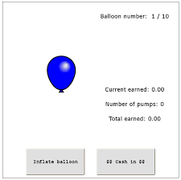
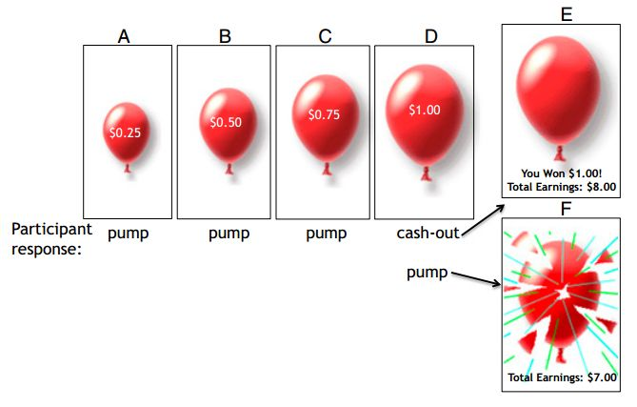
BART
The Balloon Analogue Risk Test (BART) is a psychological assessment used to measure risk-taking behavior.
In the test, participants "pump" a virtual balloon to inflate it and accumulate money, with the risk of the balloon popping and losing all the accumulated money.
The test gauges participants' willingness to take risks based on how much they inflate the balloon before it bursts.

Slide 9
Expected results
Number of clicks in BART

Slide 10
Implication
Illuminate some of the negative consequences of self affirmation in the current body of research
Probe if self affirmation can cause over confidence (in further research)
Adjust risky behaviors of employees in the work place by self affirming or disaffirming individuals (self disaffirming might pose an ethical concern)

